Slide 1

Music Genre Classification Kaggle Competition
Team-D Members:
Nesma Silman Yaser Alshuaybat Reem Alshaarany

Slide 2
Introduction
As part of the Shai for AI machine learning engineering internship, we participated in a Kaggle competition aimed at classifying music genre based on various features. This project highlighted the importance of simplicity and a proper understanding of the process.
Team D's approach involved each member independently developing the project from start to finish. Throughout the process, members shared information on their initial actions, dataset insights, interesting discoveries, and challenges encountered.

Slide 3
Dataset Overview
Training dataset: contains the attributes of almost 14,395 songs, with 18 columns including the target column, which classifies the Genre of each song
Testing dataset: contains 3600 observations.
Missing Values: The training and test datasets contained missing values in the 'Popularity', 'key', and 'Instrumentalness' columns.

Slide 4
Evaluation Metric
The F1 score was used as the evaluation metric for this classification task. The F1 score is the harmonic mean of precision and recall.
0 (Worst) to 1 (Best)
The formula for the F1 score is:
𝐹 1 - Score = 2 × precision × recall / precision + recall​

Slide 5
Data Cleaning and Preprocessing
We conducted several steps to clean and pre-process the data, including handling missing values, dropping irrelevant columns, and checking duplicate records. Key takeaways:
Irrelevant Features: The 'Track Name’ due to having many repeated names.
Imputation: Missing values in the 'Popularity', 'key', and 'Instrumentalness' columns were replaced with the respective column's median.

Slide 6

Exploratory Data Analysis (EDA)
During the EDA phase, we examined the dataset to gain insights into the distribution of key features and their relationships.
Histograms: To visualize the distribution of individual features.
Boxplots: To identify outliers and understand the spread of the data.
Correlation Heatmaps: To explore relationships between features and identify potential multicollinearity.

Slide 7
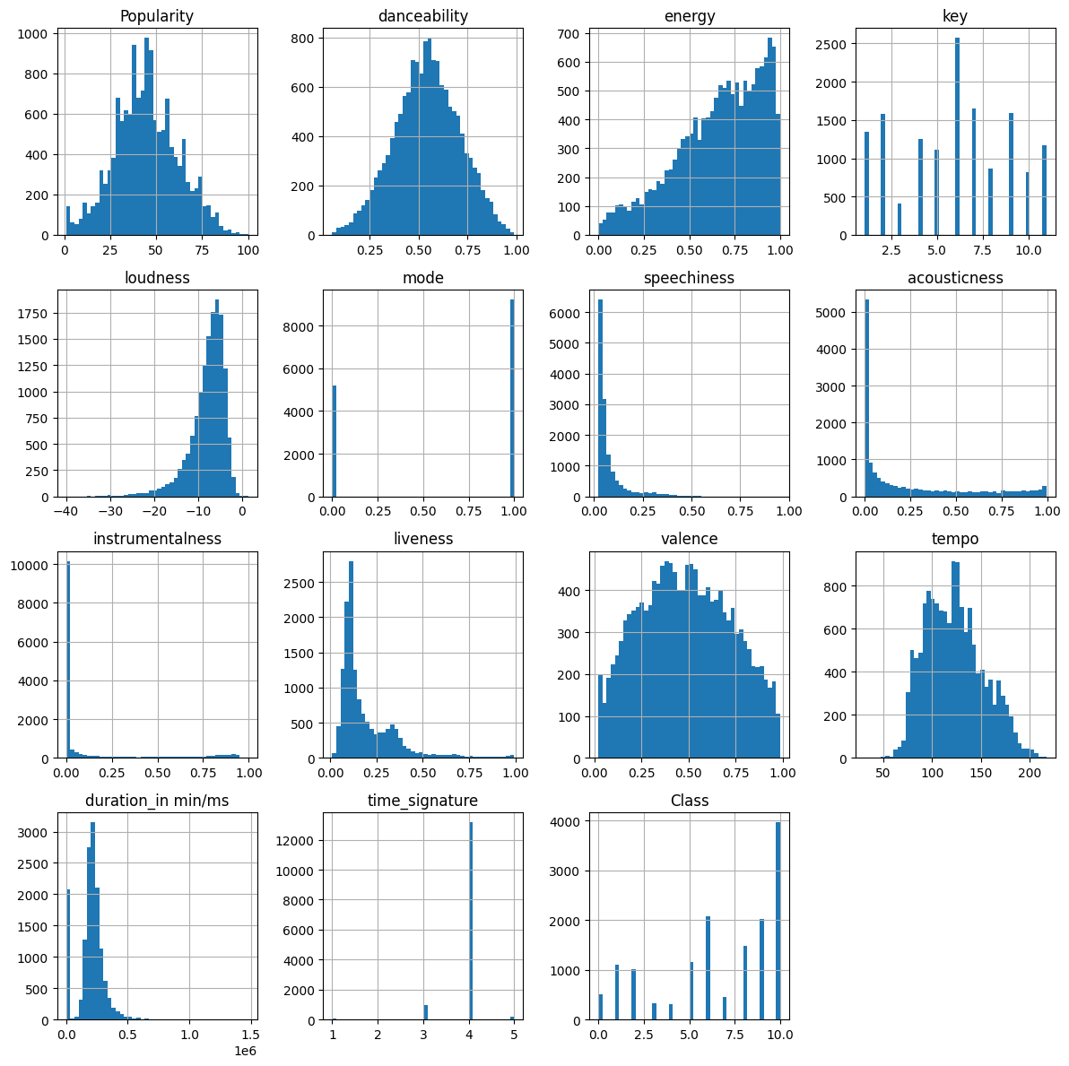
What is the features’ spread?

Slide 8
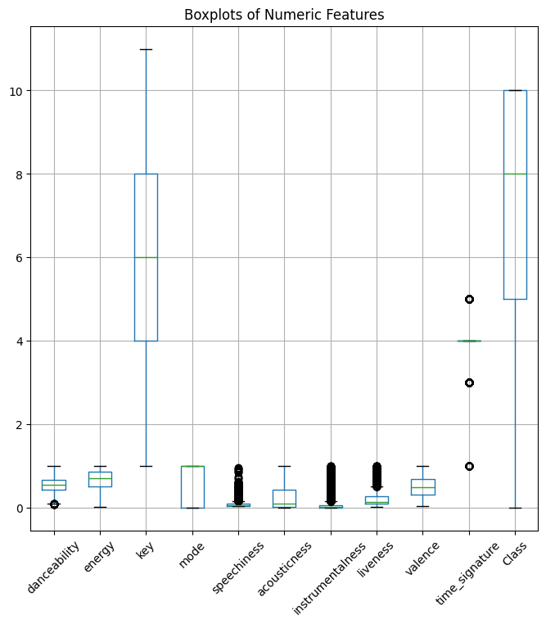
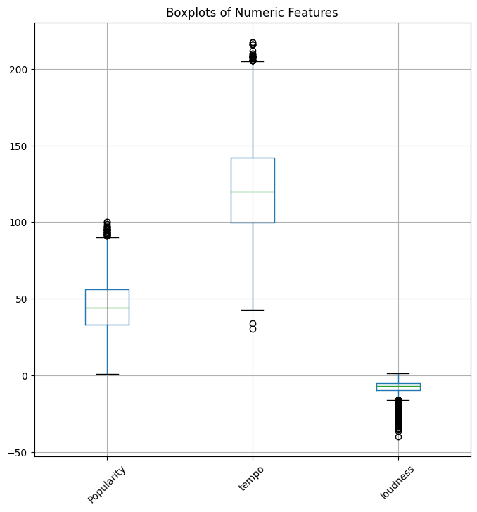
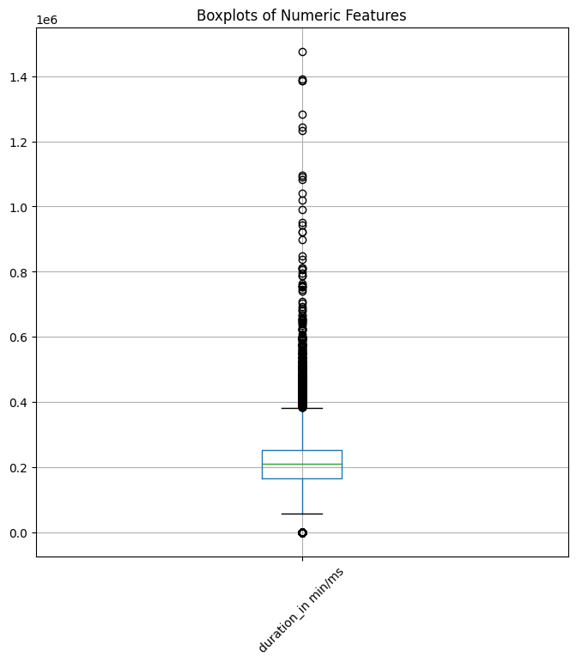
Hunting for Outliers

Slide 9
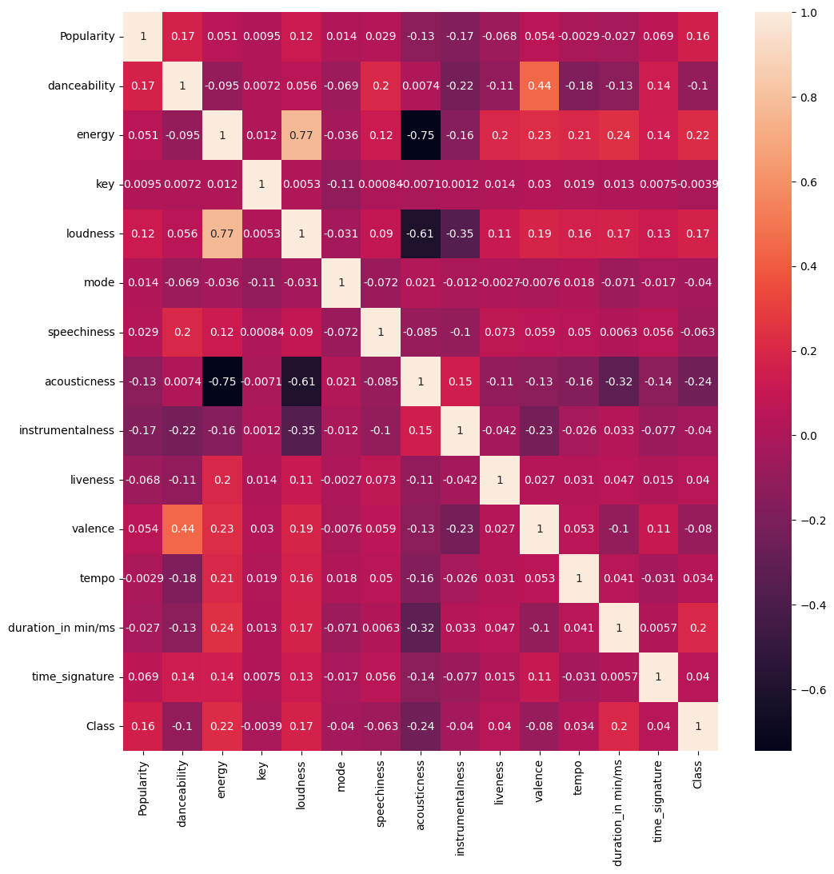
Understanding Inner Relationships between numeric features

Slide 10
Key takeaways:
Feature Distributions: Features such as ' Speechiness’, 'Acousticness', and 'Loudness' showed skewness. Boxplots: Many outliers were noticed in the ‘Duration_in_milliseconds’ feature. Correlations: A hint of multicollinearity was noticed in features with high correlation.
Given these takeaways and constraints, it was important to utilize a model that is not significantly affected by outliers and skewness.

Slide 11

Model Selection and Evaluation
CatBoost
Classifier
F1 : 0.6672
Logistic
Regression
F1 : 0.5478
Decision Tree
Classifier
F1 : 0. 4781
Random
Forest
Classifier
F1 : 0. 5935

Slide 12
Model Selection and Evaluation
Key takeaways:
CatBoost, a gradient boosting algorithm, handles categorical features directly and achieved the highest F1-score using simple one-hot encoding.
Other models needed more complex frequency encoding for best results, adding a level of computation complexity.

Slide 13


Final Prediction and Submission
Best model achieved an F1-score of 66.7%.
Predictions saved in CSV format for submission.

Slide 14
Conclusion
Successfully classified music genres using machine learning.
Future work: Address class imbalance and explore advanced features.

Slide 15

Thank you
Any Questions ?

